Slide 1
Activity Diagram

Slide 2
Activity Diagram
An activity diagram portrays the control flow from a start point to a finish point showing the various decision paths that exist while the activity is being executed.

Slide 3
Activity Diagram
We can depict both sequential processing and concurrent processing of activities using an activity diagram.
They are used in business and process modeling where their primary use is to depict the dynamic aspects of a system.
An activity diagram is very similar to a flowchart. So let us understand if an activity diagrams or a flowcharts are any different :

Slide 4
Difference between an Activity diagram and a Flowchart
Flowcharts were typically invented earlier than activity diagrams.
Non programmers use Flow charts to model workflows.
For example: A manufacturer uses a flow chart to explain and illustrate how a particular product is manufactured. We can call a flowchart a primitive version of an activity diagram. Business processes where decision making is involved is expressed using a flow chart.

Slide 5
Difference between an Activity diagram and a Flowchart
So, programmers use activity diagrams (advanced version of a flowchart) to depict workflows. An activity diagram is used by developers to understand the flow of programs on a high level. It also enables them to figure out constraints and conditions that cause particular events.

Slide 6
Difference between a Use case diagram and an Activity diagram
An activity diagram is used to model the workflow depicting conditions, constraints, sequential and concurrent activities. On the other hand, the purpose of a Use Case is to just depict the functionality i.e. what the system does and not how it is done.

Slide 7

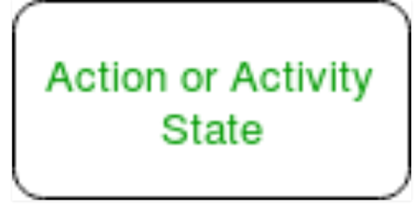
Activity Diagram Notations –
Initial State – The starting state before an activity takes place is depicted using the initial state
Action or Activity State – An activity represents execution of an action on objects or by objects. We represent an activity using a rectangle with rounded corners. Basically any action or event that takes place is represented using an activity.

Slide 8
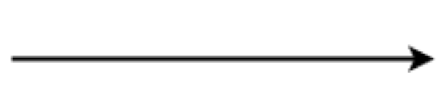
Activity Diagram Notations –
Action Flow or Control flows – Action flows or Control flows are also referred to as paths and edges. They are used to show the transition from one activity state to another

Slide 9
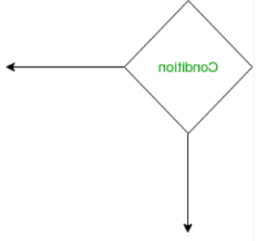
Activity Diagram Notations –
Decision node and Branching – When we need to make a decision before deciding the flow of control, we use the decision node.

Slide 10
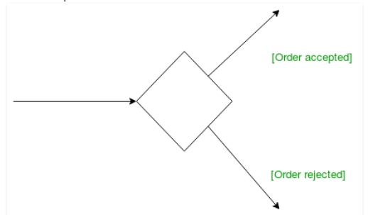
Activity Diagram Notations –
Guards – A Guard refers to a statement written next to a decision node on an arrow sometimes within square brackets

Slide 11
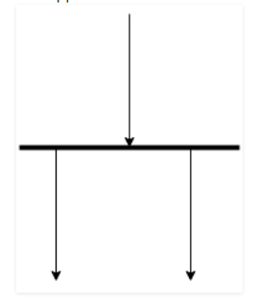
Activity Diagram Notations –
Fork – Fork nodes are used to support concurrent activities
When we use a fork node when both the activities get executed concurrently i.e. no decision is made before splitting the activity into two parts. Both parts need to be executed in case of a fork statement.

Slide 12
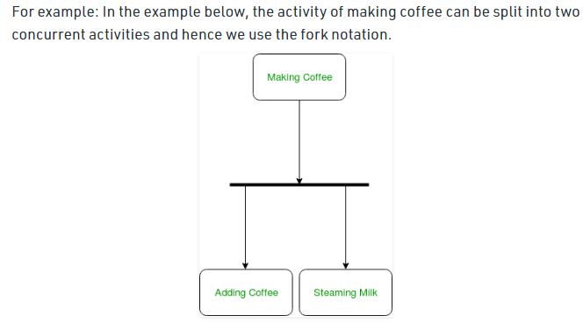
Example

Slide 13
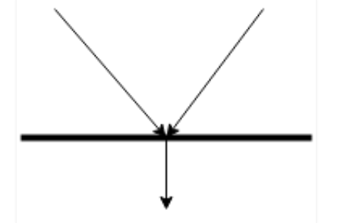
Activity Diagram Notations –
Join – Join nodes are used to support concurrent activities converging into one. For join notations we have two or more incoming edges and one outgoing edge.

Slide 14
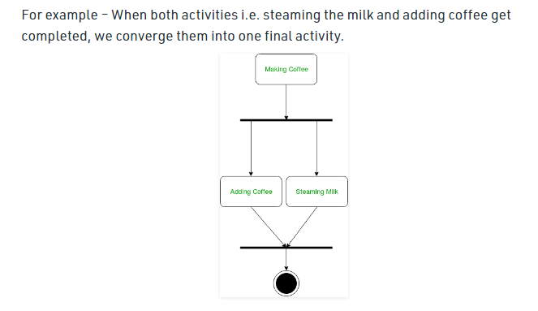
Activity Diagram Notations –

Slide 15
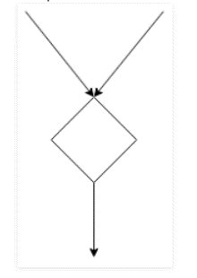
Activity Diagram Notations –
Merge or Merge Event – Scenarios arise when activities which are not being executed concurrently have to be merged

Slide 16
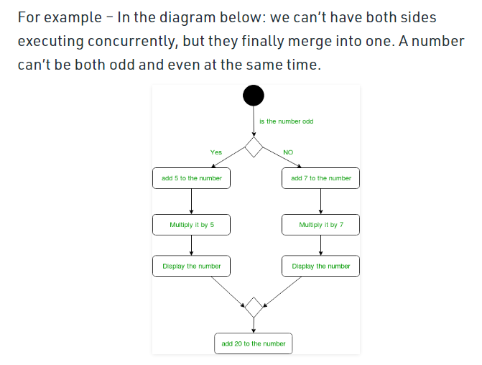
Activity Diagram Notations –

Slide 17
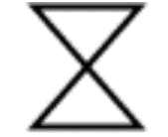
Time Event
We can have a scenario where an event takes some time to complete. We use an hourglass to represent a time event.

Slide 18
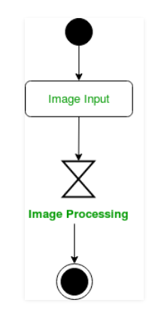
Example
For example – Let us assume that the processing of an image takes takes a lot of time. Then it can be represented as shown below.

Slide 19

Activity Diagram Notations –
Final State or End State – The state which the system reaches when a particular process or activity ends is known as a Final State or End State. We use a filled circle within a circle notation to represent the final state in a state machine diagram. A system or a process can have multiple final states.

Slide 20
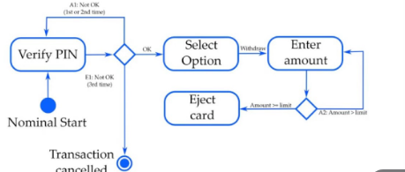
Activity Diagram Notations –

Slide 21
Activity Diagram - Modeling a Word Processor
The activity diagram example below describes the workflow for a word process to create a document through the following steps:
Open the word processing package.
Create a file.
Save the file under a unique name within its directory.
Type the document.
If graphics are necessary, open the graphics package, create the graphics, and paste the graphics into the document.
If a spreadsheet is necessary, open the spreadsheet package, create the spreadsheet, and paste the spreadsheet into the document.
Save the file.
Print a hard copy of the document.
Exit the word processing package.

Slide 22
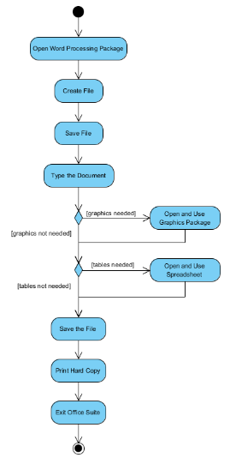
Example

Slide 23
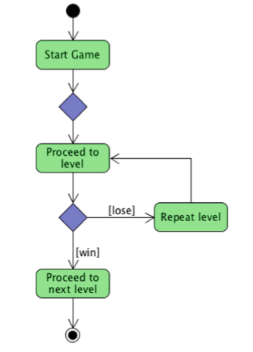
Example

Slide 24
Activity Diagram Example - Student Enrollment
This UML activity diagram example describes a process for student enrollment in a university as follows:
An applicant wants to enroll in the university.
The applicant hands a filled out copy of Enrollment Form.
The registrar inspects the forms.
The registrar determines that the forms have been filled out properly.
The registrar informs student to attend in university overview presentation.
The registrar helps the student to enroll in seminars
The registrar asks the student to pay for the initial tuition.

Slide 25
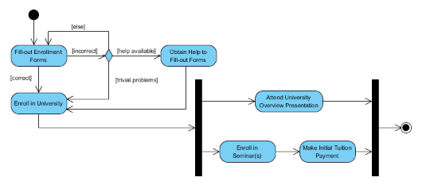
Example

Slide 26
How to Draw an activity diagram –
Identify the initial state and the final states.
Identify the intermediate activities needed to reach the final state from he initial state.
Identify the conditions or constraints which cause the system to change control flow.
Draw the diagram with appropriate notations.

Slide 27
Uses of an Activity Diagram
Dynamic modelling of the system or a process.
Illustrate the various steps involved in a UML use case.
Model software elements like methods, operations and functions.
We can use Activity diagrams to depict concurrent activities easily.
Show the constraints, conditions and logic behind algorithms.

